Slide 1

UNICORN EXPLOSION
Andrew
Burhan
Ben
Yashika
Macade
Kalan

Slide 2


Slide 3

Objectives
Create an interactive game
Construct a map generator
Design various level difficulties
Display results on 7-Segment

Slide 4
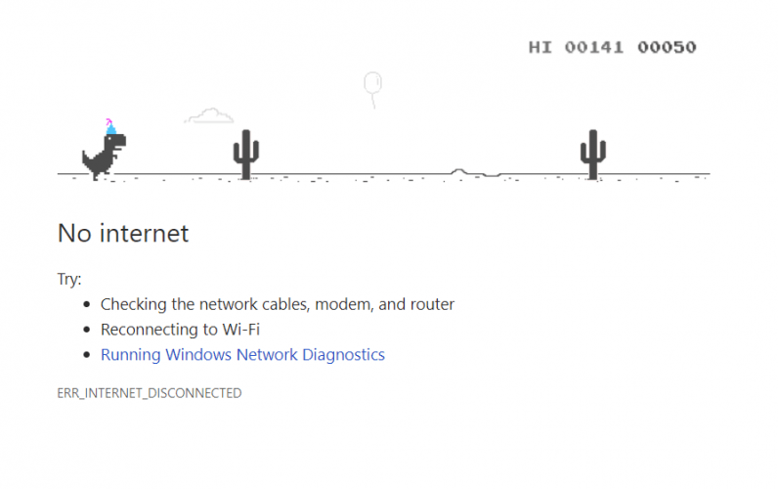
Origin of Idea

Slide 5
Main Modules
Physics Engine
Map Generator
Audio Controller
Display Controller
Score Keeper

Slide 6

Map Generator
Generate 16-bit register
Used 4-bit four numbers
Three Outputs: Empty, Low block, Top block
Shift map left to add 2-bits on the right

Slide 7

Physics Engine
Receive output from the map generator
Process the logic based on the input
Use clock signal to synchronize operations
Continuously check the status of game

Slide 8

Audio Controller
Convert binary to analog signals
Pass digital output through an amplifier
Generate a square wave
Implement output to headphone jack
Two Effects: Jumping - Dying

Slide 9
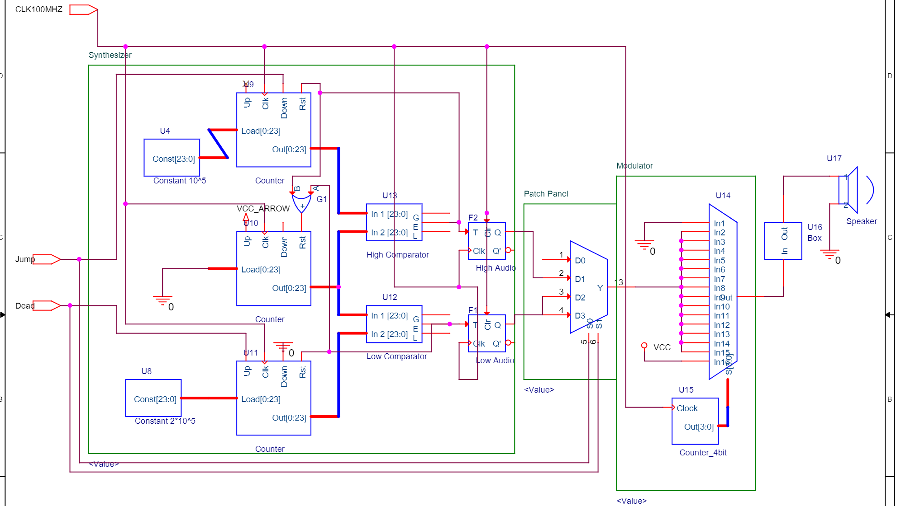

Slide 10
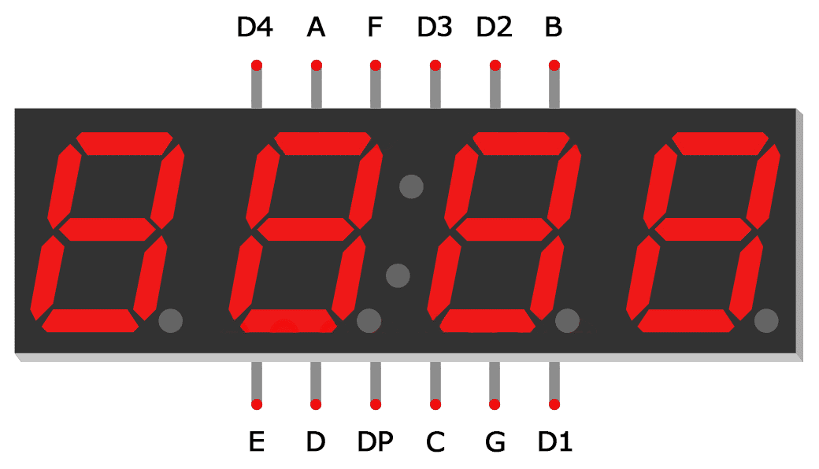
Display Controller
Take inputs from the physics engine
Use a 3-bit decoder to represent different cases
Generate an 8-bit output to display the shape required
Eight different cases are implemented

Slide 11
Display Cases:
Unicorn up w/
obstacle down
Unicorn down w/
obstacle up
Dead
Empty
Unicorn down
Unicorn up
Obstacle down
Obstacle up

Slide 12

Score Keeper
Use a counter to record the output from the physics engine
Pass the registered score array to the display engine
Higher Difficulty = Higher Score
Final score saved to 32-bit array

Slide 13

Any Questions

Slide 14

Verilog Code

